Slide 1
Thin-Film-Hydrogen-Sensor Typ I
Al₂O₃
measuring the resistance change of the PdNi wires due to H2-Exposure

Slide 2
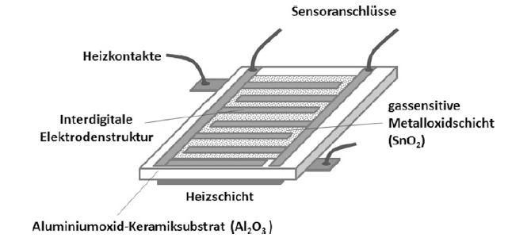
Thin-Film-Hydrogen-Sensor
interdigital Pt-electrodes
gassensitive Pd /Ni thin Film
measuring the resistance change of the PdNi thin film due to H2-Exposure

Slide 3
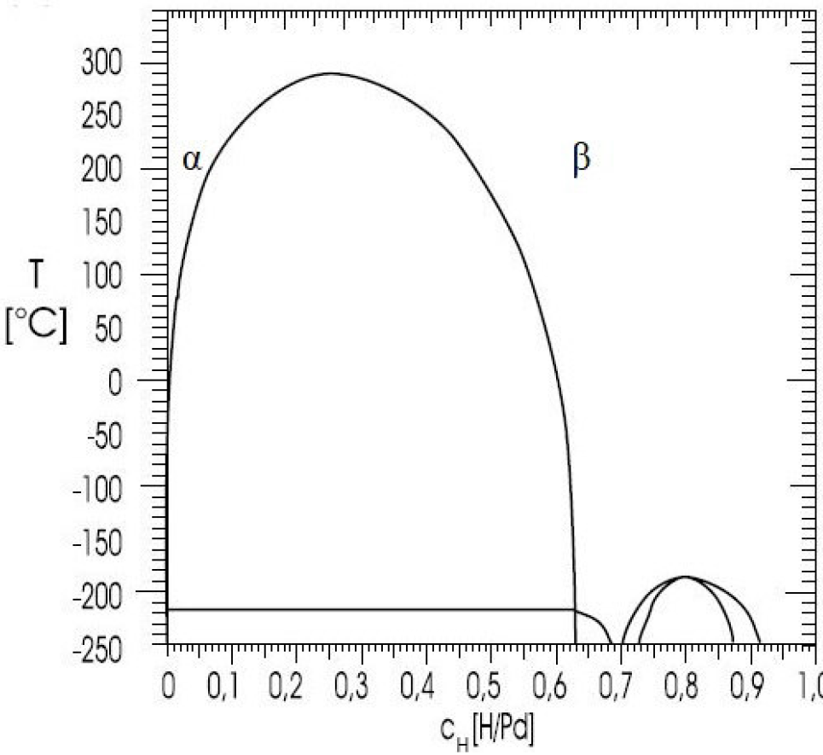
properties of Pd alloy
α-Phase | β-Phase
electrically conductive | semiconductive, high resistive
metallic opaque | transparent
depeding on H-content in the Pd-crystal lattice

Slide 4
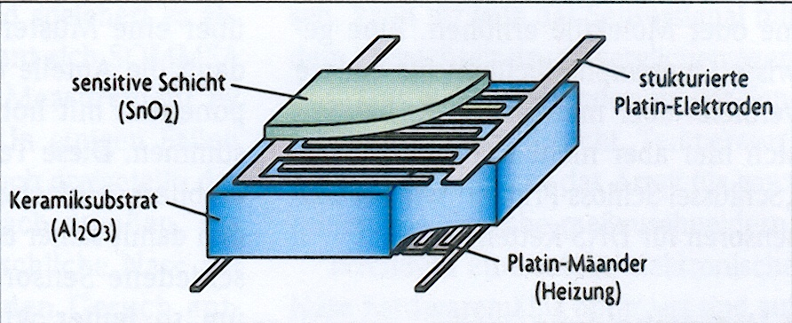
Halbleiter Gas-Sensor
„Elektronische Nase“

Slide 5
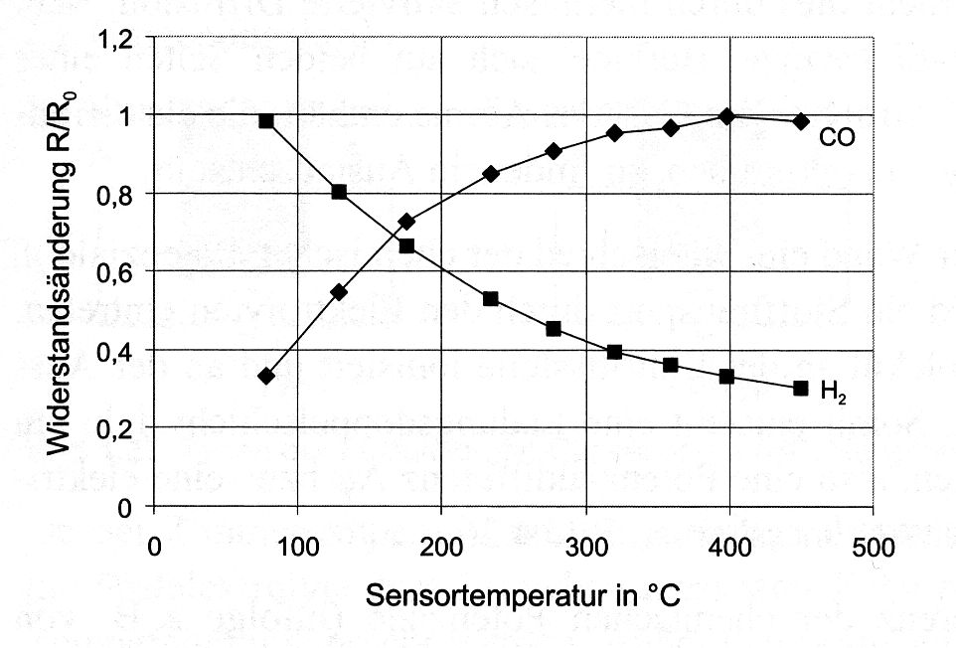
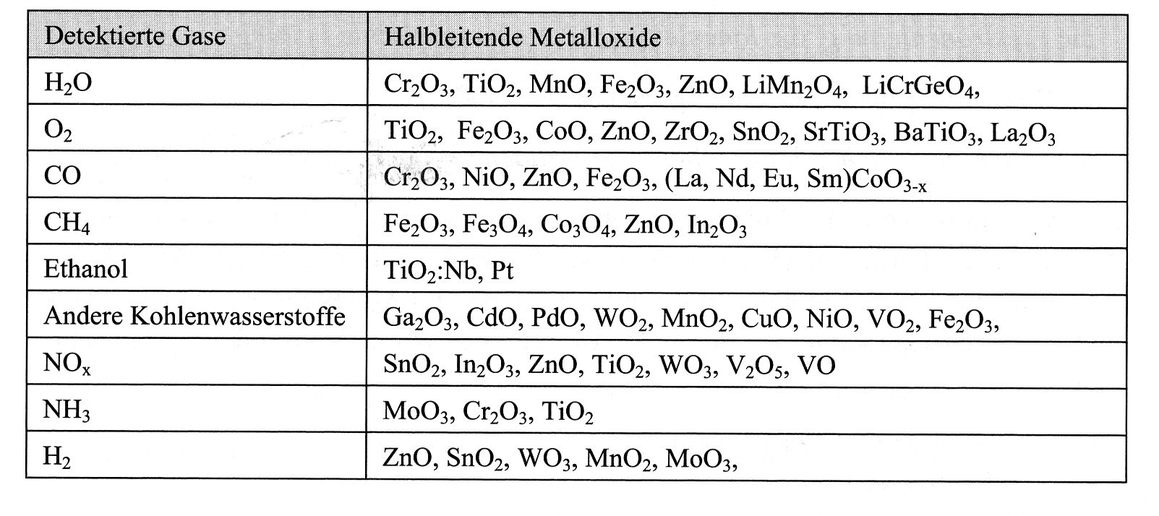
Chemische Sensoren

Slide 6
Halbleiter Gas-Sensor
„Elektronische Nase“

Slide 8
Microscopy

Slide 9
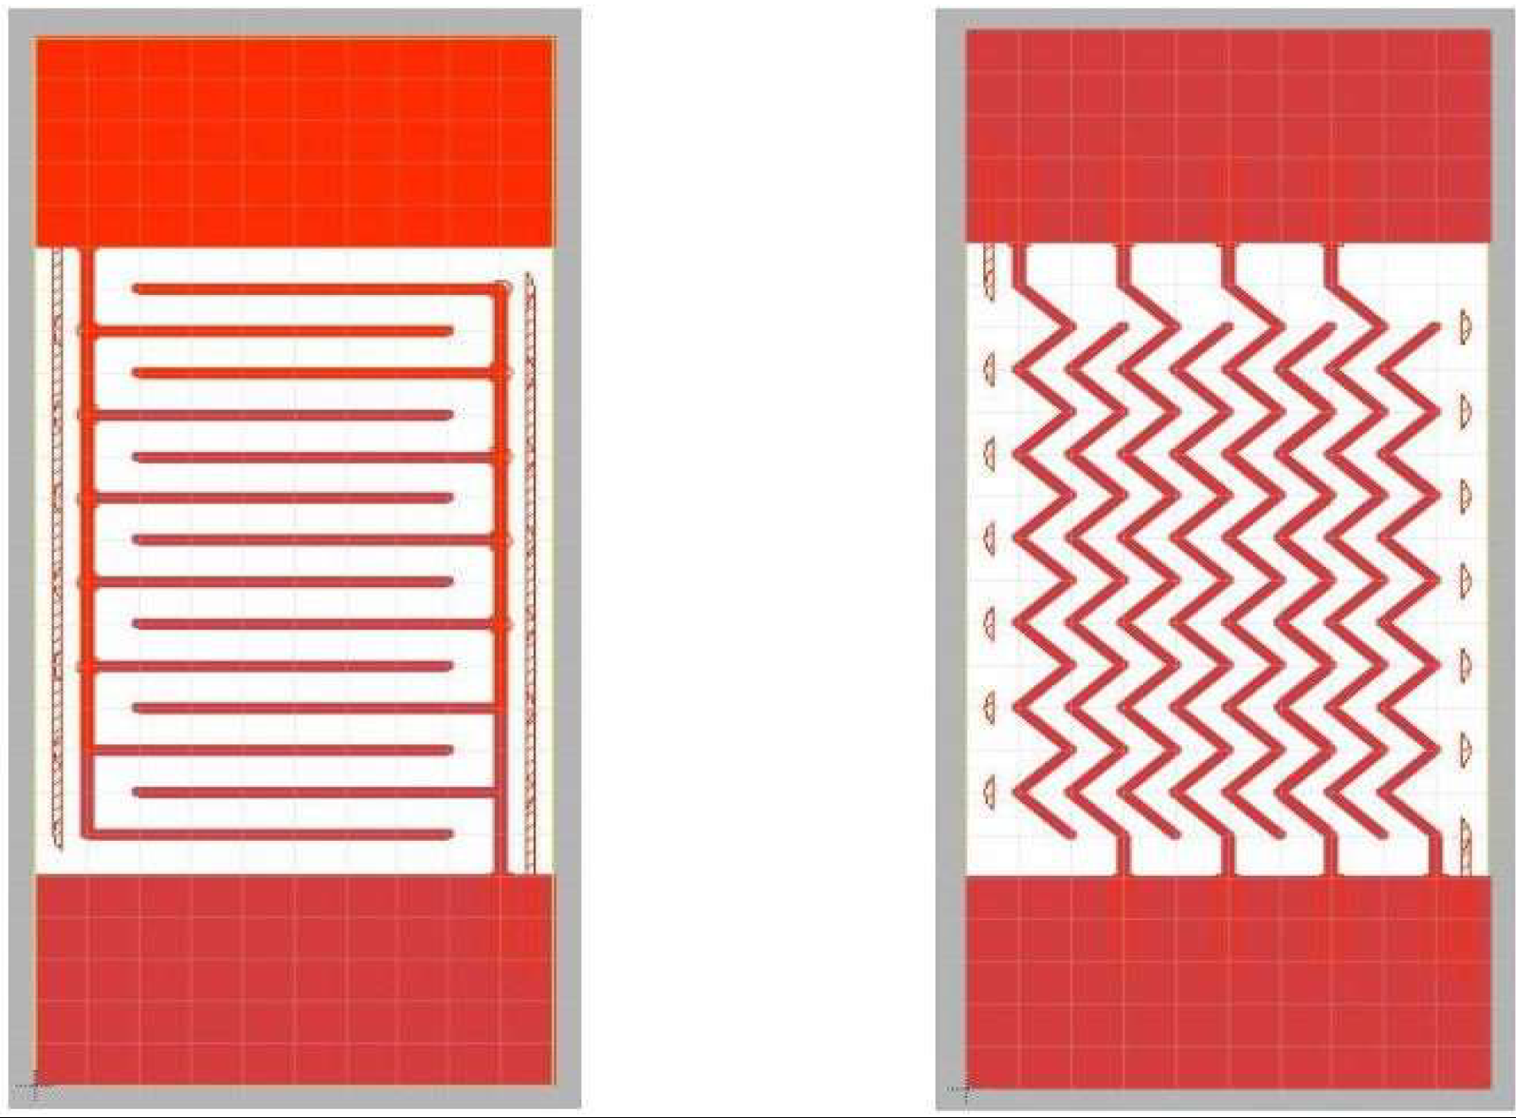
design of electrodes
created by eagle software
varying width, length and distances
data file required for laser etching
Comb and Zig Zig Electrode structure

Slide 10
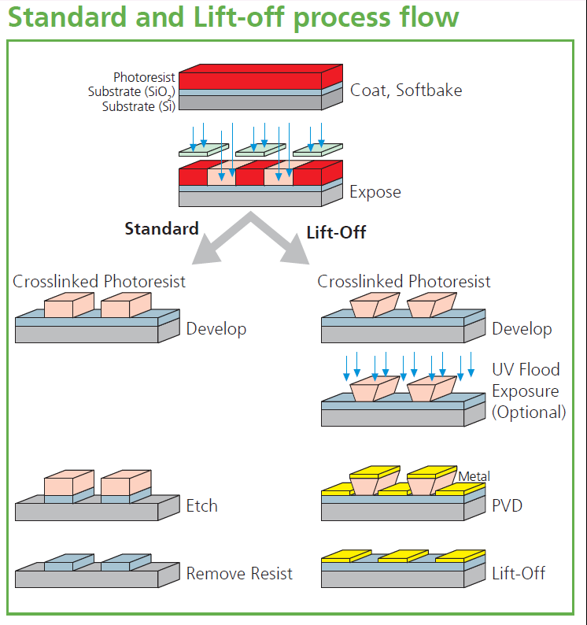
Structuring thin film by Lithography

Slide 11
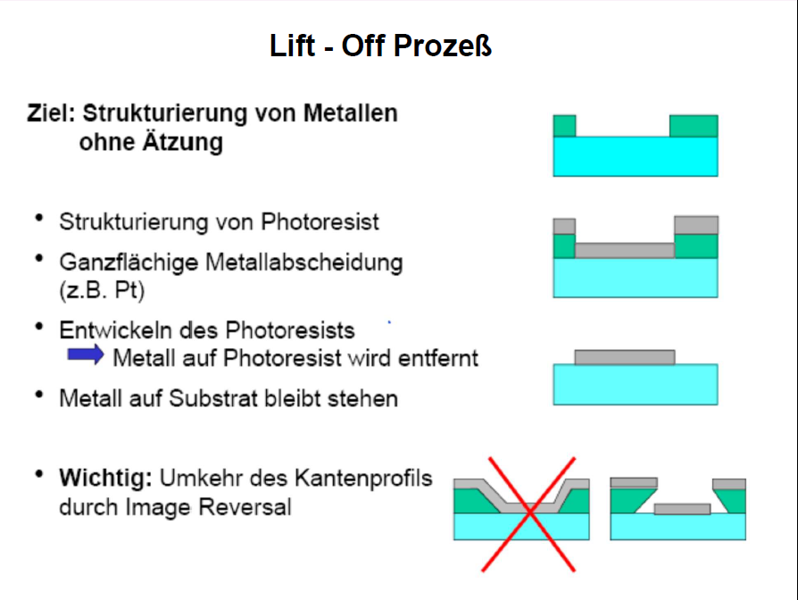
Lift-Off Process
Aim: Structuring metal thin films without etching!
1. Structuring photoresist (exposure, development)
2. deposition of metallic thin film (ex. Pd)
3. stripping photoresist
4. resist with metal will be removed, structured
metal on substrate remains

Slide 12
Sputtering

Slide 13
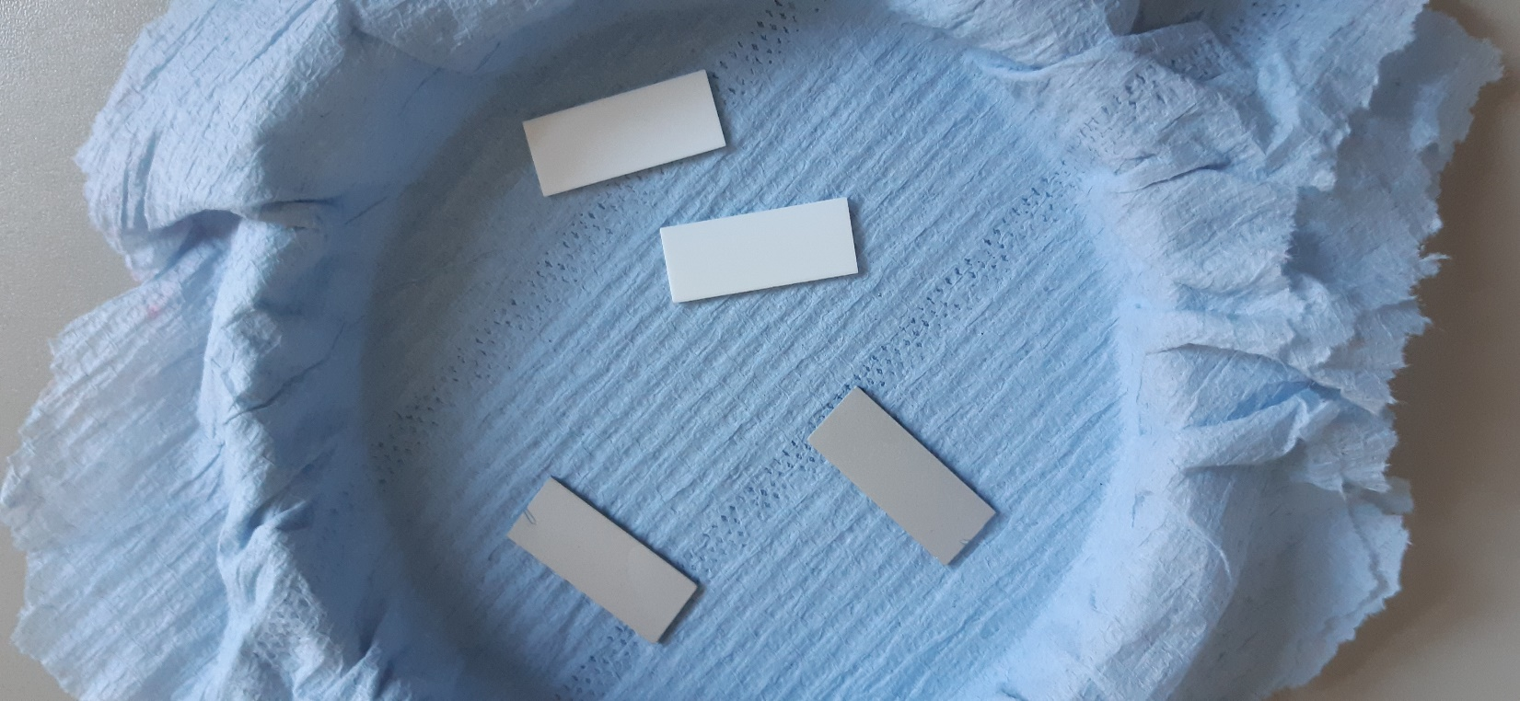
Sputtering PdNi alloy
to compare: coated and uncoated Alumina platles
after sputtering at 4x10⁻³ mbar Ar, 55 W Power, 5 min

Slide 14
Laser structuring

Slide 15
measuring under H2-Exposure

Slide 16
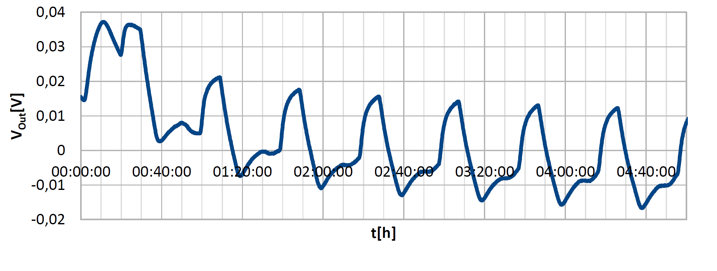
measuring under CH4-Exposure

